Slide 1



Digital Twins
1

Slide 2
DIGITAL TWINS
A virtual replica of a system / object
The concept was first introduced at the NASA during the apollos' mission.
Since then, the concept as evolved to revolve around more interactivity and visualization through new technologies of visualization (web, AR, VR, etc…) and algorithmic (machine learning etc…).
Main goals:
Simulate Past or Complex Events
Optimize processes
Being helpful for decision-making
2

Slide 3
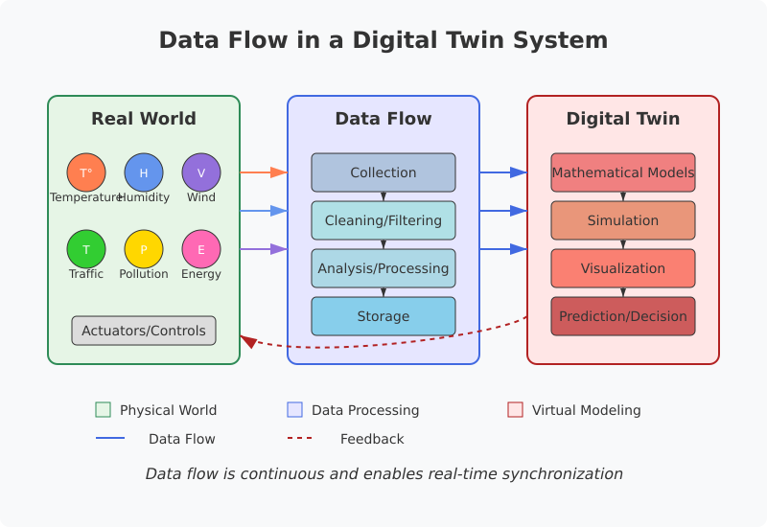
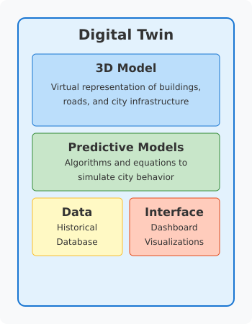
Structure and data flow in a Digital Twin
The four stages of development:
Data Acquisition (through sensors and networks)
Data Cleaning and Training
Simulation and Action
Learning and Iteration
3

Slide 4

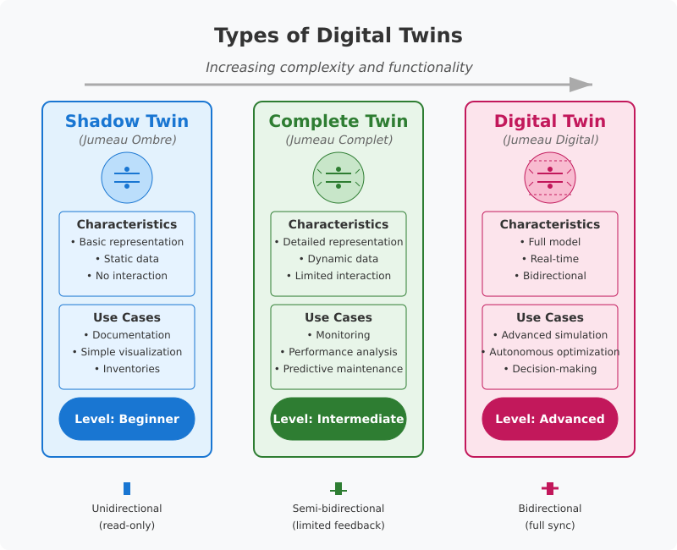


4

Slide 5

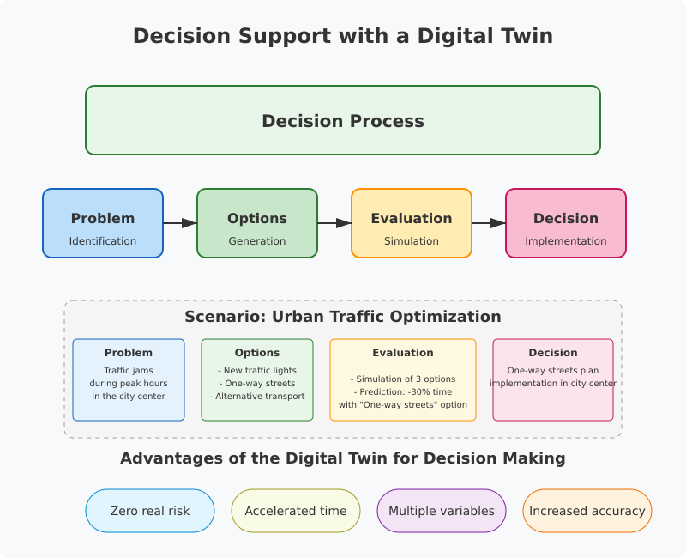
5

Slide 6
THE SOCIO-ECOLOGIC IMPACT
In an era where climate change is rapidly transforming ecosystems, creating Digital Twins provides a powerful way to communicate information and data to a wide range of audiences through dashboards and interactive visualizations.
The goal of this project is to maintain maximum transparency and keep data as open as possible while educating stakeholders in the territory, fostering a "learning territory" approach.
6

Slide 7
TERRITORIAL WEAKNESSES AND RISKS
Freshwater resources : Most of the water is provided by the Ospedale’s dam, which is regularly confronted to risk of drought, especially in August when the overtourism waves strikes.
Forest Fires and floods
Other weaknesses/risks
transport and mobility
waste management
energy management
7

Slide 8
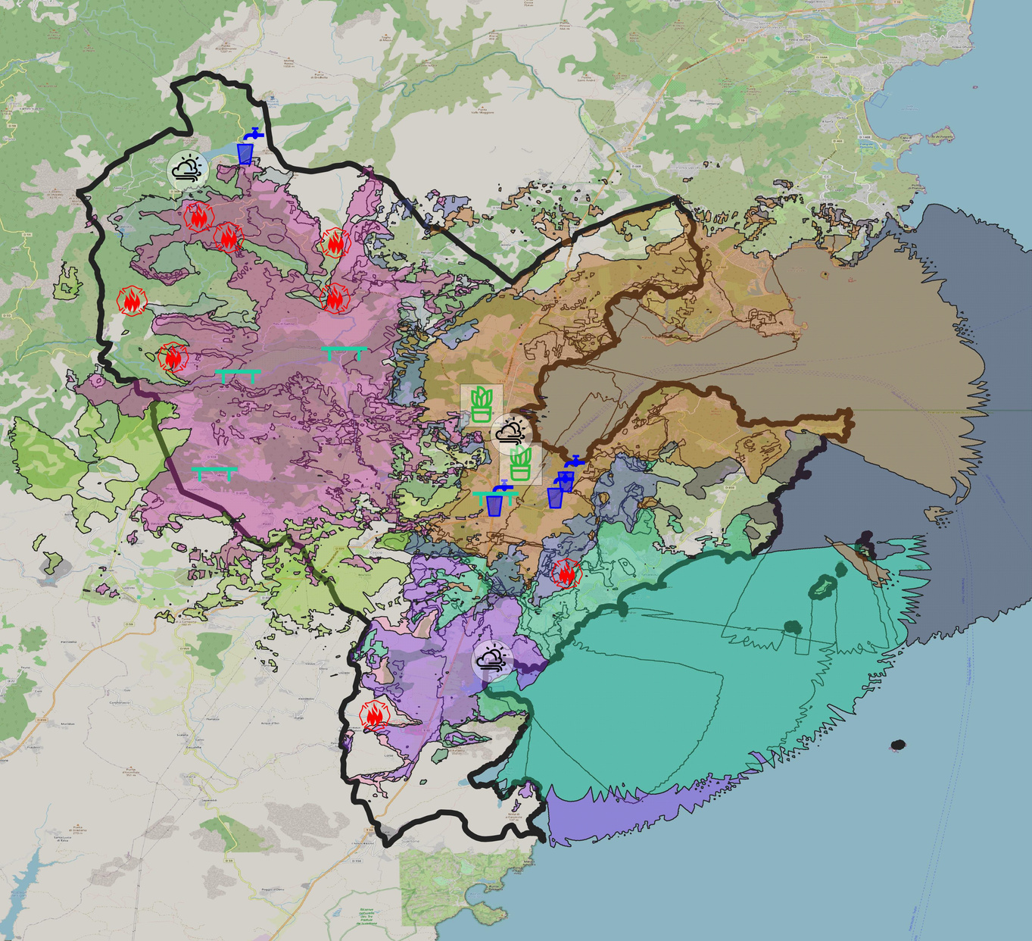
PLAN OF ACTION FOR ENVIRONMENTAL SURVEILLANCE
11 LoRaWAN antennas (networking)
4 smart Gardens
4 bridge flood surveillance sensors
8 tank level filling sensors for firefighters
3 weather forecast stations
4 quantitative and qualitative sensors for fresh water analysis
8

Slide 9
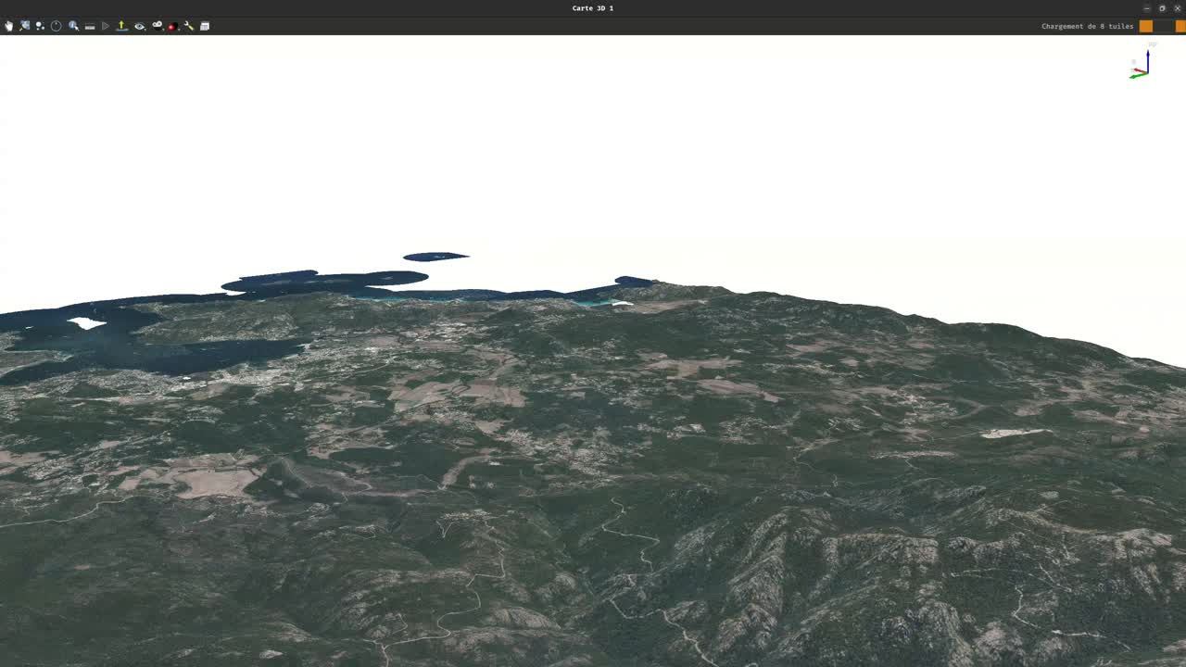
EXEMPLE OF VISUALITON
9

Slide 10
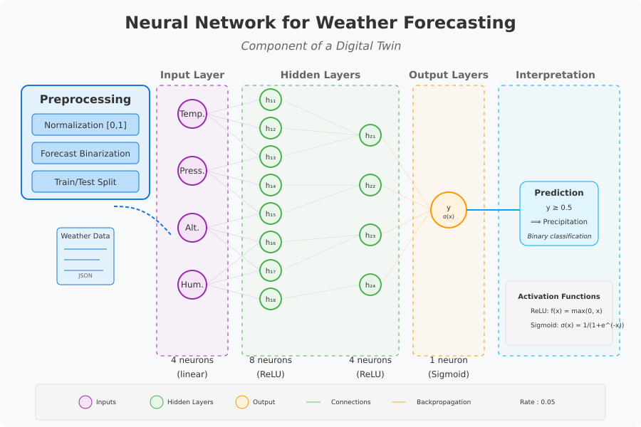
Example of a simple neural network for weather forecast
4 inputs neuron, 8+4 hidden neuron, 1 output neuron
Machine learning and modeling algorithm will be important components of the future digital twin
10

Slide 11
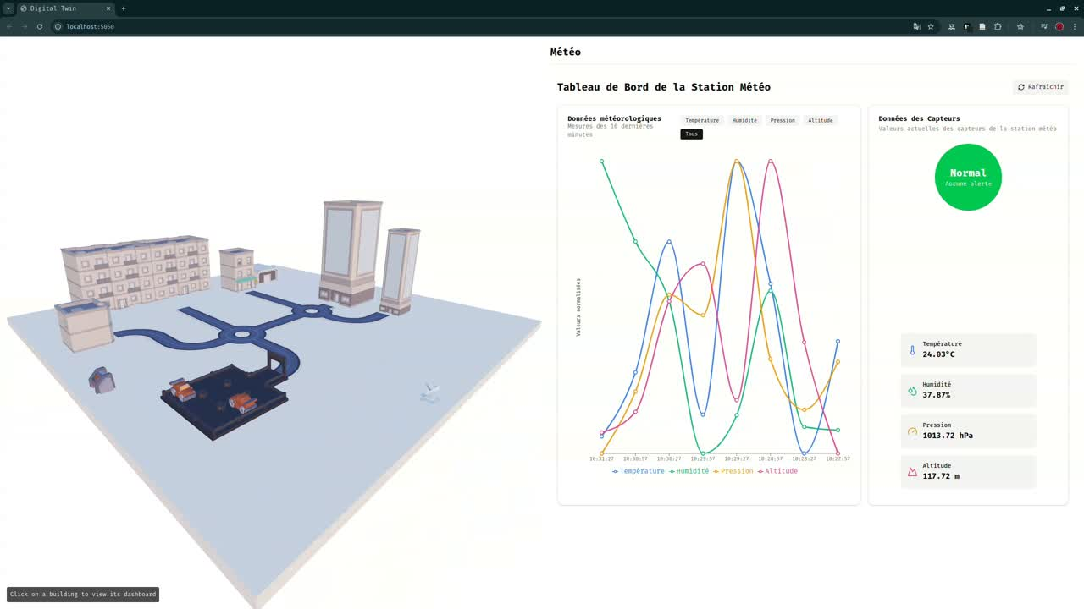
Interactive Demo of a shadow twin
throught the hypervisor dashboard and other supervisor, we can monitor and interact with different component of the city
11

